Slide 1

Data Science and technical social networking
Guest lecture – Data Analysis
Karthik Srinivasan
Doctoral student (2nd Year) at University of Arizona
EXTC - KJSCE (2005-2009)
17th July,2015
EXTC Department – K J Somaiya College of Engineering, Mumbai

Slide 2
Contents of today’s talk
Introduction to Data Science (DS)
The joy of technical networking
What is it?
Why should I care?
The Economics of DS
About the speaker
Discussion and questions

Slide 3
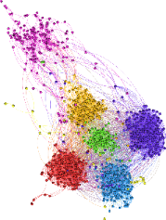
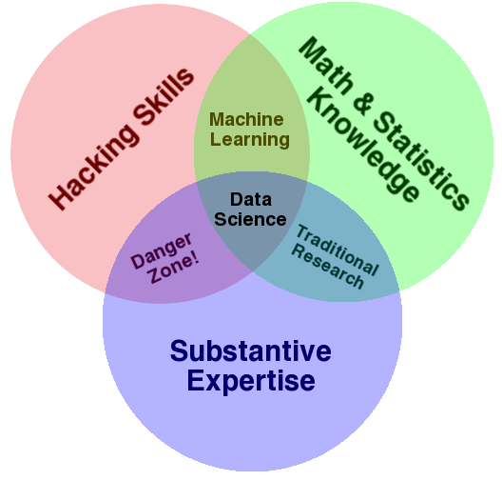
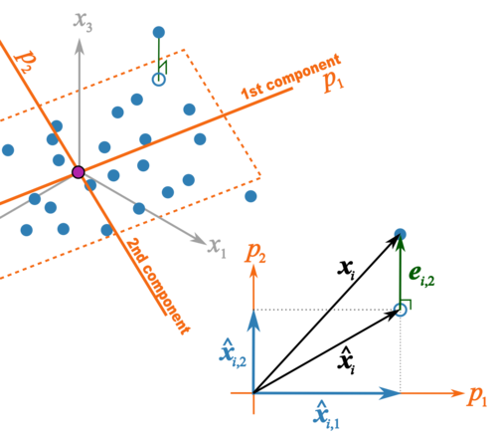
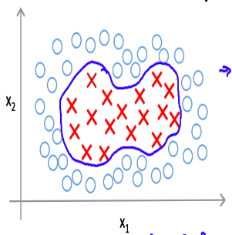
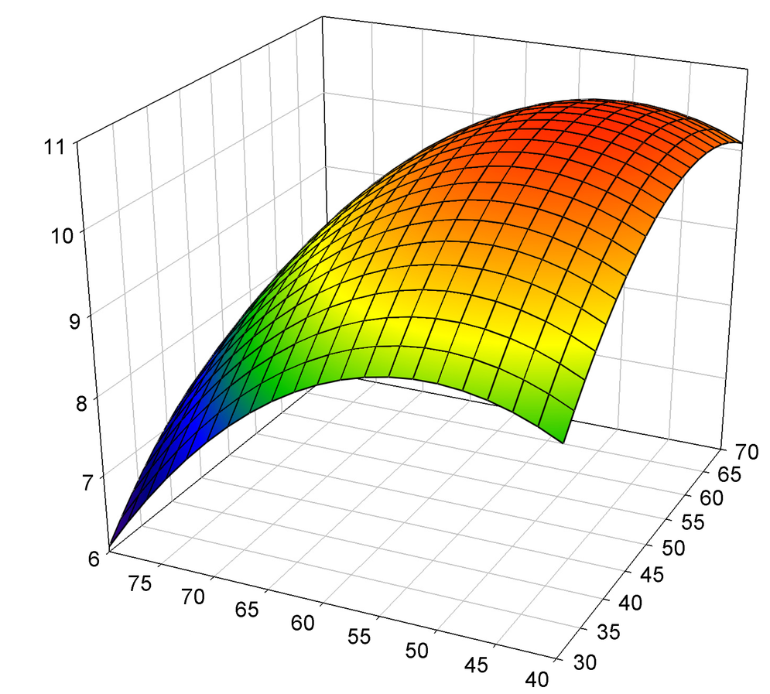
What is Data Science?
Data scientists are the people who understand how to fish out answers to important business questions from today’s tsunami of unstructured information
- From HBR article “Data Scientist: The Sexiest Job of the 21st Century” (2012)
Drew Conway’s Venn diagram
Associated terms for the green circle: Machine learning, Data mining, Data analysis, Big Data, Large scale data analysis, Statistical learning, Operations research, Decision models, Econometrics, Business Analytics, Business Intelligence, MIS, deep learning, web analytics, scraping, social media analytics

Slide 4
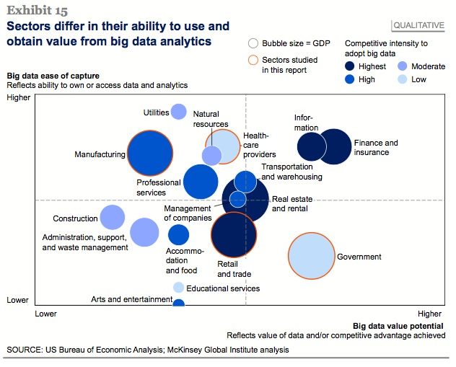
Why Data Science? - A career perspective
SUPPLY
DEMAND
MBA
Earn $/₹
+
Satisfactory career
KJSCE - EXTC
Masters
Work
Dream job OR/AND Better chances of getting admission in good programs OR/AND Stable career development
Source: McKinsey Global Institute on Data science in US economy
A Data Scientist, IT earns an average salary of ₹ 618,430 and $ 92,000 in US per year (source: Payscale.com)
US (alone) will experience a shortage of 190,000 skilled data scientists by 2018 - McKinsey

Slide 5
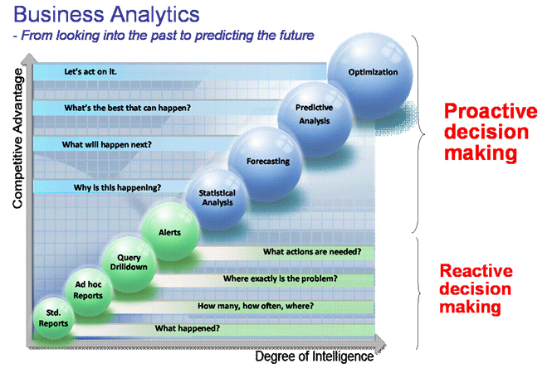
Every company wants to be smart
Source: ST Electronics accessed at http://www.stee.stengg.com/group/infosoftware/solutions/egov/business.html#

Slide 6
An example: Data science in Manufacturing
Text
Process Improvement
Knowledge Discovery
Statistical models
Statistical process control
Hazard models
Data Visualization
Graph Modeling
Predictive Analytics
Supervised Machine Learning
Unsupervised Machine Learning
Physical models
Design of Experiments
Stochastic optimization
Curve fitting

Slide 7
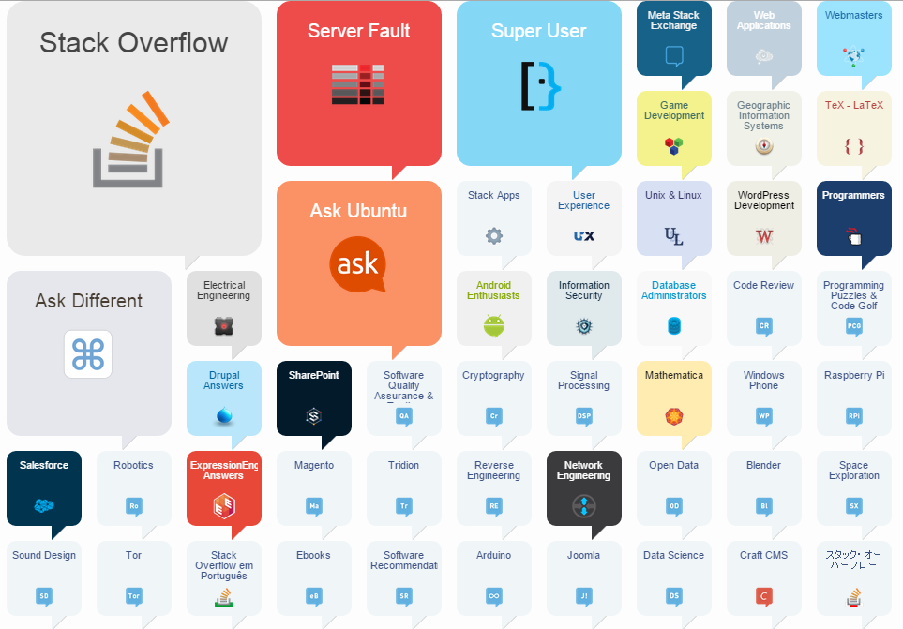
The joy of technical networking - Become a responsible e-citizen
How: Use and contribute to
Why:
Open source
Stack Exchange
Wikipedia
Twitter
Github
Youtube
Linkedin
Topic blogs
You find your own answers and become aware of current affairs in technology
‘Power’ employers lookout for active contributors
You realize how much you know in the global workforce in your domain
Exponential career paths of open-source contributors

Slide 8






About the speaker
Statistical learning & Data Mining
Keen to learn
Big data architecture
Graphical models
Network analysis
Decision models
Design of experiments
Natural language processing
High-dimensional analysis
Advanced visualizations
Current toolset
Current Research Area: Environment impact on individual well-being in offices
My past adventures:

Slide 9
THANK YOU
Feel free to contact me at karthiks@email.arizona.edu OR:
https://www.linkedin.com/in/karanalytics
https://twitter.com/karthikarizona
https://github.com/kartucson
http://stackoverflow.com/users/2896323/earnest-learner

